Slide 1
Spettrometria di Massa in proteomica
Lezione 07 – Biochimica applicata

Slide 2
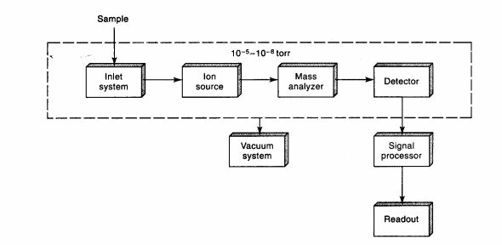
Modern Mass Spectrometer (MS) Systems
MS systems used for proteomics have 4 tasks:
Create ions from analyte molecules
Separate the ions based on charge and mass
Detect ions and determine their mass-to-charge
Select and fragment ions of interest to provide structural information (MS/MS)

Slide 3
Ionizzazione con Elettrospray
Possible Sample Inlets
Syringe Pump Sample Injection
La spettrometria di massa rileva sempre il rapporto m/z di un composto
Loop
Autosampler, HPLC
Capillary Electrophoresis
Liquid
Expansion of the Ion Formation and Sampling Regions
Nitrogen Drying Gas
Electrospray Needle
3-5 kV
Atmosphere
Vacuum
Liquid
Nebulizing Gas
Droplets Containing Solvated Ions
Ions

Slide 4
Isotopes
Most elements have more than one stable isotope.
For example, most carbon atoms have a mass of 12 Da, but in nature, 1.1% of C atoms have an extra neutron, making their mass 13 Da.
Why do we care?
Mass spectrometers “see” the isotope peaks provided; the resolution is high enough.
If an MS instrument has resolution high enough to resolve these isotopes, better mass accuracy is achieved.

Slide 5
Stable isotopes of most abundant elements of peptides
Element | Mass | Abundance
H | 1.0078 | 99.985%
 | 2.0141 | 0.015
C | 12.0000 | 98.89
 | 13.0034 | 1.11
N | 14.0031 | 99.64
 | 15.0001 | 0.36
O | 15.9949 | 99.76
 | 16.9991 | 0.04
 | 17.9992
 |  | 0.20

Slide 6
Massa monoisotopica
We use instruments that resolve the isotopes enabling us to accurately measure the monoisotopic mass
Monoisotopic mass; all ¹²C, no ¹³C atoms
One ¹³C atom
Two ¹³C atoms
Angiotensin I (MW = 1295.6) (M+H)+ = C62 H90 N17 O14
Monoisotopic mass
corresponds to
lowest mass peak
La massa monoisotopica di una molecola è la somma delle masse accurate per l'isotopo più abbondante di ciascun elemento presente. All'aumentare del numero di atomi di un dato elemento, aumenta anche la percentuale della popolazione di molecole che hanno uno o più atomi di un isotopo più pesante di questo elemento. Il contributo più significativo al modello di picco isotopico per i peptidi è l'isotopo 13C di carbonio (1,1%) ed azoto 15N (0,36%).

Slide 7
Esempio: identificaione di Nociceptina
Peptide 3: MW = 1806.6 F-G-G-F-T-G-A-R-K-S-A-R-K-L-A-N-Q
Peptide 2: MW = 1096.2 F-G-G-F-T-G-A-R-K-S-A
Peptide 1: MW = 584.2 F-G-G-F-T-G
Peptide 3 (M+H)1+
Isotope spacing = 1.0:
Ion is singly charged: (M+H)¹⁺ MW = 584.2
Nociceptin 1-6
Peptide 2 (M +2H)2+
Peptide 3 (M+3H)3+
Nociceptin 1-11
Isotope spacing = 0.5:
2+
Isotope spacing = 0.3: Triply charged: (M+3H)³⁺ MW = 1806.6
Doubly charged: (M+2H) MW = 1096.2
Nociceptin 1-17
Peptide 2 (-H, +Na)
586.2
603.5

Slide 8
Discovery Proteomics: differential expression profiling by MS
Biological Samples (case vs. control)
LC-MS/MS Data Analysis
Protein Mixtures
Biofluids
Tissue lysates
Separate and Analyze Peptides by LC-MS/MS
Search DB using peptide m/z and sequence
digest to peptides
fractionate peptides
m/z and intensity of peptides
rich pattern
Fragment ions for sequence
Peptide identity
Protein identity
Relative abundance

Slide 9
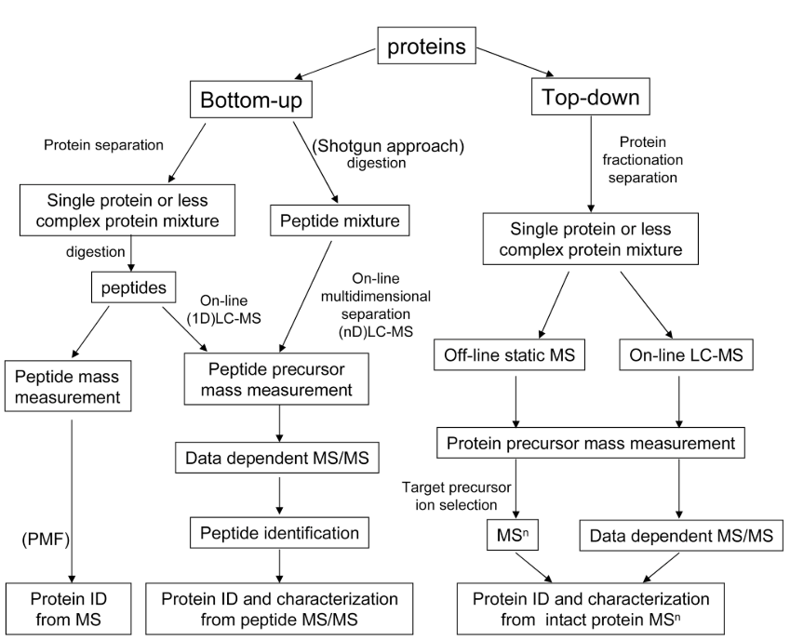
Discovery Proteomics: differential expression profiling by MS

Slide 10
Approccio Top-DOWN
Il campione viene analizzato intatto
•• Utile per single proteine
•• Distingue variazioni di sequenza
•• Permette l’analisis di modificazioni combinatoriali di protein (esempio modificazione degli istoni)
•• Dove non arriva
Strumentazione molto complessa (non accessibile a tutti)
Il campione richiede passaggi di purificazione precisi
Interpretazione del dato piu’ complessa e poco automatica
Copertura del proteome decisamente ridotta

Slide 11
Approccio Bottom UP
Il campione e’ digerito da peptidasi prima della MS
Advantages:
Data acquisition easily automated
Fragmentation of tryptic peptides well understood
Reliable software available for analysis
Separation of peptides to create less complex subsets of the proteome for MS analysis is far easier than for proteins (relates to breadth and depth of coverage)
Disadvantages:
Simple relationship between peptide and protein lost
Took highly complex mixture and made it 20-100x more complex
Puts high analytical demands on instrumentation

Slide 12
Processamento del Campione 1
Riduzione ed Alkilazione
•• stabilizzazione del campione in forma ridotta per garantire l’accesso alla digestione

Slide 13
Processamento del Campione 2
Proteasi con elevate specificita’
•• Trypsin
•• Lys-C
•• Staph. V8
•• Asp-N
C-terminal to Arg and Lys C-terminal to Lys
C-terminal to Glu and Asp N-terminal to Asp
Proteasi a scarsa specificita’
•• | Chymotrypsin | C-terminal to aromatic, aliphatic
•• | Proteinase K, Thermolysis | (e.g., Tyr, Trp, Phe, Leu) C-terminal to aromatic, aliphatic

Slide 14
Discovery Proteomics: differential expression profiling by MS
Biological Samples
(case vs. control)
Protein Mixtures
• Biofluids
• Tissue lysates
• digest to peptides
• fractionate peptides
LC-MS/MS
Data Analysis
Search DB using peptide m/z and sequence
• Peptide identity
• Protein identity
• Relative abundance
Separate and Analyze Peptides by LC-MS/MS
m/z and intensity of peptides
rich pattern
Fragment ions for sequence

Slide 15
Peptide Sequencing by LC/MS/MS
peptide from protein of interest
MS-1
Collision Cell
MS-2
I
Q
E
K
L
COOH
NH
F
NH₂ Y
NH₂ Y
NH₂
2
1D or 2D LC
separation
G G G
G
Y Y Y
G
G F
G F
Y
G
NH
G
2
L
COOH
NH
2
F
L
NH₂
G
G G
F F F
L L L
L
COOH COOH
COOH
COOH
COOH
S
A
M
A
P
Trypsin digest
Reduce, alkylate
N
A
R
S
P
N
Select mass from peptide of interest
Sequence
peptide of interest
proteins

Slide 16
Quante Mass Spec?
intact peptide parent ions
Scan m/z 350-1200
Pass All ions
Pass All ions
MS
Collision Cell (off)
MS 1
MS 2
MS or mass spectrum
HPLC
Column
MS/MS
Collision Cell (on)
Fragment all ions
Pass m/z 834-838
Pass All ions
MS/MS spectrum of doubly charge ion at m/z 836.5
MS/MS means using two mass analyzers (combined in one instrument) to select an analyte (ion) from a mixture, then generate fragments from it to give structural information.

Slide 17
Dominant fragment ions observed by collision- induced dissociation (CID) of peptides
b ions
y ions

Slide 18
Automated Peptide Sequencing by LC/MS/MS
RT : 0 .0 1 -­‐ 9 0 .15
_{A} B
Total Ion Current Trace produced during LC-MS/NL:MS
10 0
80
60
340
50 5
12 54
9 .54 E 7
Relative Abundance
385
465
510
B as e P eak F : + c F ull ms [
3 0 0 .0 0 -­‐
2 0 0 0 .0 0 ]
4 15
645 ₆₉₅
114 5
1150
12 9 9
40
3 35
53 5
555 ₆ ₃₀
6 50
70 5
79 5 8 6 0
76 0
10 15 10 6 0 ¹⁰ ⁷⁰
175
295
875 925 ⁹⁵⁵
116 5 ₁₁₇₅
13 0 4
20
₁₄ ₀ 17 0
18 0 2 50
58 5
9 70
13 59
13 0 9
13 6 9
0
41 31
14 6 9
5 10
535.8
403.9
493.6
616.6
10 00
15
20
25
30
35
40
45
T ime (min)
50 55 60 65
500.6 684.6
750.0
713.0
10 00
m/z
70
75
80 85
90
Relative Abundance
10 0
0
A
Relative Abundance
10 0
B
50
50
0
50 0
150 0
2000
50 0
m/z
150 0
2000
^{658.9} MS/MS 535.8
Relative Abundance
10 0
644.0
MS/MS 500.6
Relative Abundance
10 0
653.0
59 6 .7
_{318.2} 511.0 _{814.7}
849.5 1154 .6 13 6 1.6
50 0 10 00 150 0
m/z
50
59 8 .5
50
Relative Abundance
10 0
^{52 6 .9}MS/MS 403.9
Relative Abundance
10 0
MS/MS 684.6
0
^{213.1} 469.5 ^{56 5.1 70 0 .5} 10 14 .2 1119 .3
200 400 600 800 10 00 12 00 14 00
m/z
_{471.0} 698.2
897.4
968.4 119 6 .5 16 05.5
50 0 10 00 150 0 2000
m/z
0
50
Relative Abundance
10 0
59 6 .2
MS/MS 493.6
50
Relative Abundance
10 0
712 .6
MS/MS 750.0
^{156 .9} 374.4 ^{491.5} 683.2 79 6 .3 897.3
200 400 600 800 10 00 12 00
m/z
698.5
967.3
457.3 942.4 ^{12 25.4}
10 95.3
^{262.2} 12 86 .3
50 0 10 00 150 0 2000
m/z
0
572 .5 _{641.1}
_{443.1} 54 3 .5
289.1 ^{677.1} 778 .9 892.1 1153 .0
50 0 10 00
m/z
0
50
59 8 .6
50
Relative Abundance
10 0
59 6 .2
54 3 .7
MS/MS 616.6
Relative Abundance
10 0
MS/MS 713.0
0
600.7
0
50
471.0
755.3
1-2 sec
50
677.1
8 14.6
954.4
52 0 .0
489.3
^{893.6} 10 90 .2
119 6 .4
cycle time
0
0
50 0
10 00
m/z
150 0
2000
50 0
10 00
m/z
150 0
“Top 4 Method” (modern MS systems can do up to “top 20”)

Slide 19
MS/MS Search Engines: looking up the answer in the back of the book
Acquired MS/MS spectrum
Sequence Database
(translation of transcriptome)
Theoretical spectrum
ISLLDAQSAPLR VVEELCPTPEGK DLLLQWCWENGK ECDVVSNTIIAEK GDAVFVIDALNR VPTPNVSVVDLTNR SYLFCMENSAEK PEQSDLRSWTAK
correlate
200 400 600 800 1000 1200
200 400 600 800 10001200
m/z
m/z
similarity score
Best matching database peptide
Determine peptide FDR by searching reversed DB
Algorithms: Mascot, MaxQuant, SpectrumMill, X-Tandem…

Slide 20
Rolling peptides up to the protein level
Peptide 1
Prot A
Prot B
Peptide 2
Peptide 3
Peptide 4
Peptide 5
Peptide 6
Prot E Prot D Prot X
Prot Y _{Prot Z}
Peptide 7
Peptide 8
Peptide 9
Peptide10

Slide 21
Examples of a Protein Centric Table (MaxQuant)
Protein IDs | Gene Names | Unique Peptides Rep01 | Sequence Coverage [%] | Mol. Weight [kDa] | Ratio H/ L | Ratio H/ L Count | p-value
A0ELI5 | Edc3 | 3 | 10.2 | 55.9 | 1.2 | 4 | 0.96
A0MNP4 | mCG_96 84 | 1 | 3 | 33.7 | 1.0 | 1 | 0.01
A1A549 | Tcf3 | 3 | 5.2 | 64.0 | 1.0 | 5 0 | Pep$de | Ratio H/L
A1L013 | 2510012 J08Rik | 5 | 7.8 | 90.6 | 0.78 | 8 | APEPTIDEK | 1.0
 | mCG_20 |  |  |  |  |  | YKPSTELLIR | 1.2
A1L329 | 206 | 9 | 10.9 | 109.9 | 0.86 | 16 | EWERTHEFAASLR | 1.6
A1L3B6 | mCG_19 432 | 8 | 37.4 | 28.9 | 0.73 | 19 | IAMAPEPTIDER | 0.9
 |  |  |  |  |  |  | GWQIMNCSTYK YHTLSSVTYEHLK ISEEALARGEPEPTIDEK Median | 0.5 1.5 1.2 1.2
.03
.54
.78
.66
Protein X
Table of values organized around proteins
▪▪
▪▪ A ratio that indicates a fold-change vs. a control condition
▪▪ False discovery rate or p-value statistic for each protein ratio to indicate how different from the null hypothesis (unchanged)
▪▪ A prioritized list of candidates for follow-up studies

Slide 22
Protein Inference Problem
Shared peptides: map to more than a single entry
in protein database
protein A or protein B ??
Or both?
In bottom-up proteomics the connectivity between peptides and proteins is lost
Prot A
Peptide
Prot B
Shared peptides are more prevalent with databases of higher eukaryotes due to the presence of:
▪▪ related protein family members
▪▪ alternative splice forms
▪▪ partial sequences

Slide 23
Peptide Quant to Protein Quant
▪▪ A peptide could belong to more than one protein
▪▪ Go with preponderance of the evidence to assign peptide
Occam’s razor principle
▪▪ In this case, peptide is assigned to Protein X because there are more peptides supporting it
Pep$de | Log₂ SILAC Ra$o
APEPTIDEK | 0.12
YKPSTELLIR | 0.15
EWERTHEFAASLR | 0.07
IAMAPEPTIDER | 0.21
GWQIMNCSTYK | 0.14
YHTLSSVTYEHLK | 0.29
ISEEALARGEPEPTIDEK | 0.23
EITHERWAYK | 0.22
SIMPLESEQK | 0.77
LITTLEPEPTIDER | 0.99
Protein X
Protein Y

Slide 24
Relative Quantification Methods for Discovery Proteomics
Label-free quantification (1 sample at a time)
State A State B
Chemical labeling
(up to 10 samples at a time)
State A State B
Metabolic labeling (SILAC) (up to 3 samples at a time)
State A (light)
State B (heavy)
Label
Combine
Label
Combine
Quantify Identify
m/z
m/z
m/z
• Need multiple replicates • Compression (fractionate) • Limited plex-level
• Less precise at low abund. • Cost • Humans can’t be labeled
Increasing precision

Slide 25
Label-free quantification: spectral counting or peak area
Detection likelihood is tied to abundance
Results vary depending on Instrument settings and number of peptides in protein
Label-free quantification
State A
State B
Only reliable for moderate to highly abundant proteins
Lots of missing data, especially for lower
abundance proteins
Poor precision leads to high FDR
Low throughput
Every sample run separately
Triplicate analyses required for stat. confidence
Instrument time = $; not inexpensive!
m/z

Slide 26
SILAC: Stable Isotope Labeling by Amino acids in Cell culture
Pros | Cons
Deep, highly precise quant. | Limited plex level (3 max)
Works well in most cell lines | Not practical for most model systems
Works with all PTMs | Can’t label humans
Relatively inexpensive
Metabolic labeling (SILAC) (up to 3 samples at a time)
State A (light)
State B (heavy)
Label
Combine
State A
State B
6-7 doublings in media depleted of light (¹²C₆)lysine
m/z

Slide 27
Time course of activation
Mixing samples improves data and saves instrument time
ID of p-sites requires MS/MS
Detects some proteins associated with pY-proteins

Slide 28
Chemical Labeling of Peptides: Multiplexed Quantification with Isobaric Mass Tag Reagents
Mass = 145
Isobaric tag reagents: stessa massa, ma diversa distribuzione di certi isotopi.
La massa e’ uguale durante la prima MS, ma cambia dopo la CID

Slide 29
Chemical Labeling of Peptides Multiplexed Quantification with Isobaric Mass Tag Reagents
100
80
116.1111
114.1108
117.1145
Mix Peptides from all 4 Samples: analyze by MS
291.2149
90
80
e70 n
_{d}60
a
n
u b50
60
40
20
390.2832
MS
c
same peptide from 4 different samples: Observed precursor intensity = Σ of all labeled versions
0
112 114 116 118
m/z
RelativAe
₄₀ reporter ions
720.4188
503.3672
MS/MS
30
703.2882
₂₀ 116.1111
218.0594
404.3024
462.1813
614.2397
792.3369
774.3190833.5016_{904.5338}
200.1014
331.1429
10
_{145.1086} 240.1341
352.1475
549.2076
561.3007
0
100 150 200 250 300 350 400 450 500 550 600 650 700 750 800 850 900 950
m/z
Sequence informative fragment ions
m/z

Slide 30
100
116.1111
iTRAQ Experimental Example
114.1108
Relative Abundance
80
DMSO
Kinase Inhib 1
Kinase Inhib 2
Kinase Inhib 3
Peptide #1: No effect
60
40
20
Lyse and Digest
0
112
114
116
m/z
118
Label
100
114.1107
“114”
“115”
“116”
“117”
80
Pool
Relative Abundance
Peptide #2: Sensitive to all inhibitors
60
Phosphopeptide Enrichment
40
115.1077
117.1146
20
0
112
114
116 118
m/z
LCMS
100
116.1117
114.1112
80
Relative Abundance
Peptide #3: Sensitive to inhibitors 1 &
3
60
40
20
11
7.1146
0
112
114
116
m/z
118

Slide 31
Isobaric tag reagents with higher multiplex levels now available: increased sample throughput with high sensitivity and good quantitative fidelity
3x increased throughput
9 tumor samples (4 basal; 4 luminal; 1 reference)
ref
Highly consistent quantification results
iTRAQ4
TMT6
TMT10
Log2 basal/luminal tumors

Slide 32
Analytical challenges of proteomics differ in important ways from transcriptional analysis
Lysozyme #1047-1064 RT: 14.18-14.47 AV: 18 NL: 5.58E3 T: FTMS + p NSI Full ms2 1431.40@35.00 [ 390.00-2000.00]
100
95
90
85
80
75
70
65
60
55
50
45
40
35
30
25
20
15
10
5
0
400
600
800
1000
1200
m/z
1400
1600
1800
2000
•• All possible features known
•• Sample is static during analysis
•• All features measured
•• Robust means to amplify low numbers DNA or RNA (PCR)
•• Signal not detected means feature not present
•• All possible features not known
•• Sample is dynamic during analysis
•• 20-50% of features measured
•• No protein PCR (analytics have to deal with enormous dynamic range)
•• Signal not detected means either that feature not present or feature present but not detected

Slide 33
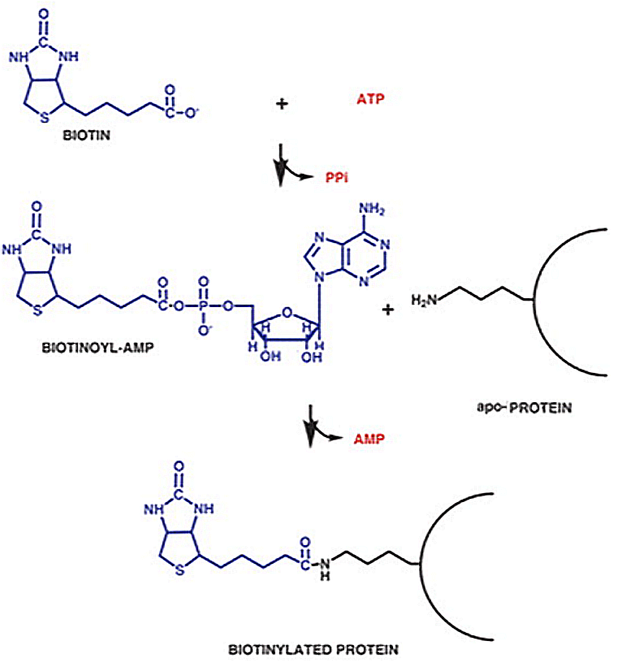
Taggin for proximity biotinilation
Reazione di BirA
Metodo enzimatico per la biotinilazione di proteine,
Precise enzimi possono rendere la biotina super reattiva
Basato sulla biotina ligase di E. Coli BirA
Il target richiede una sequenza peptidica precisa (AviTag)

Slide 34
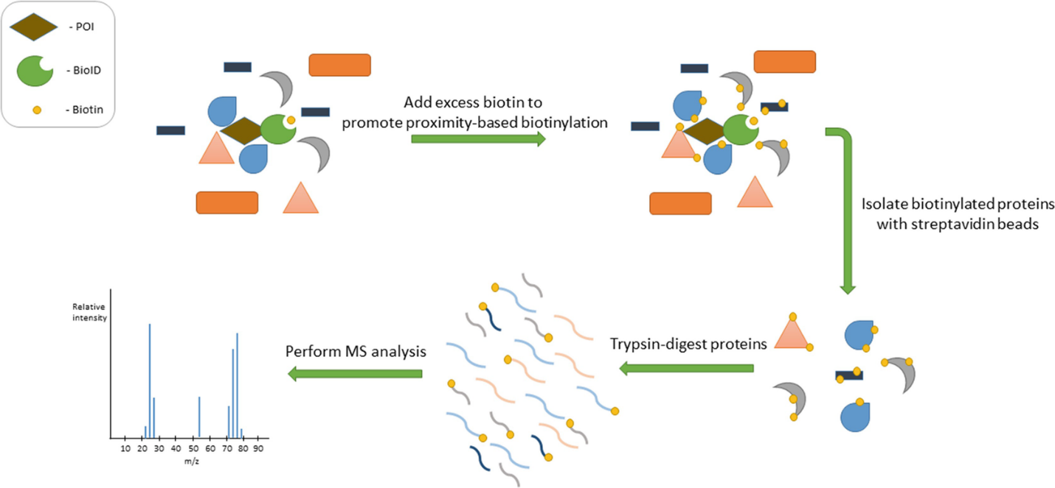
Tagging for proximity biotinilation: BioID
BioID: mutante di BirA incapace di trattenere Biotina-AMP
Biotina-AMP e’ immediatamente rilasciata dal sito catalitico e reagisce con tutte le ammine primarie disponibili (Arginina, Lysina, Glutammina, Asparagina)
Biotina-AMP emivita <20-10nm
Reazione relativamente lenta ≅ 15 ore

Slide 35
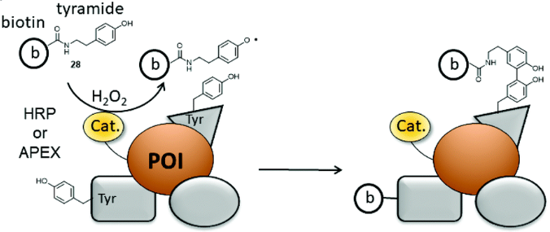
Taggin for proximity biotinilation: APEX
APEX: aspartate perossidasi
Attiva biotina tiramide (fenolo)
Richiede H2O2 come cofattore
Il radicale di biotina reagisce con sequenze ricche in elettroni (specialmente residui tirosinici)
Emivita comparabile a biotina AMP
Completa la reazione in pochi minuti
APEX
APEX

Slide 36
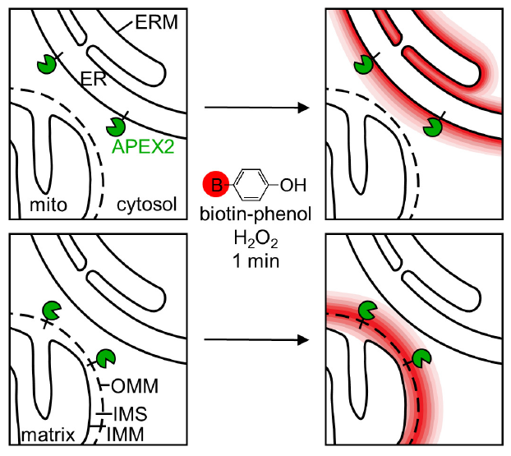
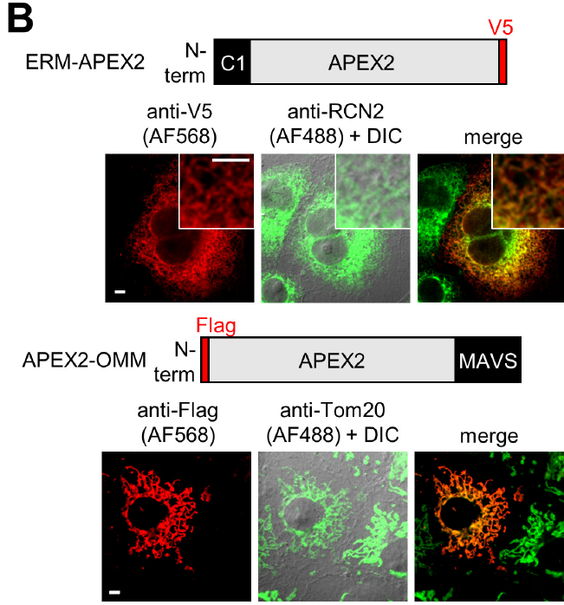
Tagging for proximity biotinilation: APEX

Slide 37
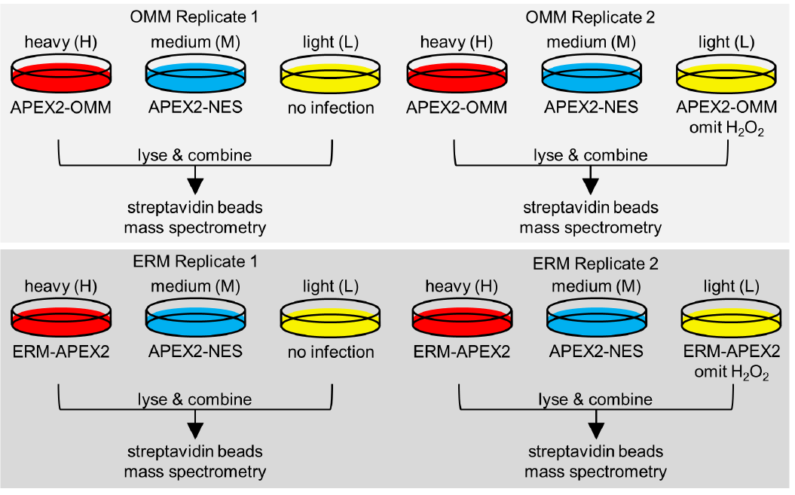
Tagging for proximity biotinilation: APEX

Slide 38
Tagging for proximity biotinilation: APEX

Slide 39
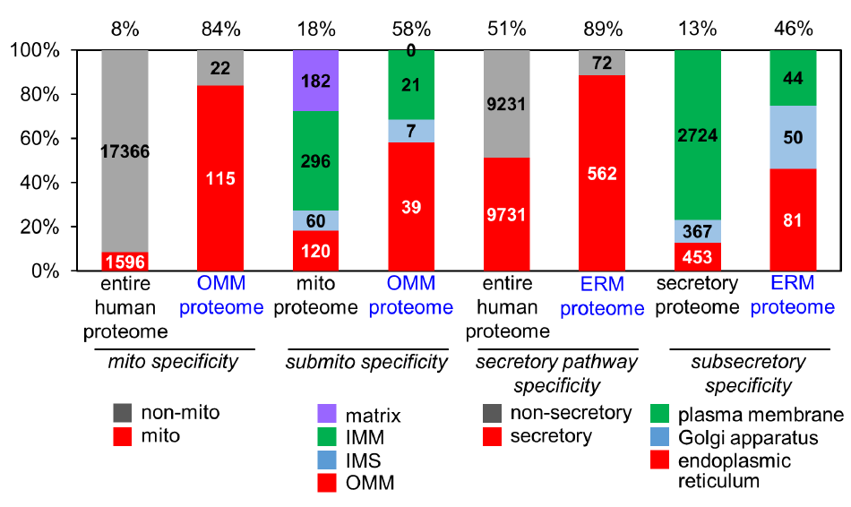
Tagging for proximity biotinilation: APEX

