Slide 1
Techniche di localizzazione proteica – Parte 2
Biochimica applicata lezione 06

Slide 2
Which scatterplot belongs to which image series?
1
2
3
4
Result: A3, B1, C4, D2
Bolte et al., Journal of Microscopy 2006,Vol. 224, 213

Slide 3
The Pearson Coefficient (PC): The Formula
Rr= 1: perfect colocalization Rr= 0: random localization Rr= -1: perfect exclusion

Slide 4
Understanding the Pearson Coefficient
PC:-0.108
PC:0.169
PC:0.446 PC:0.446 PC:0.446 PC:0.228
☺ The PC is not dependent on a constant background and on image brightness.
The PC is not easy to interpret and affected by addition of non- colocalizing signals. No perspective of both channels.

Slide 5
Manders coefficients
M1, M2 coefficient:
Proportion of overlap of each channel with the other.
(Manders et al. , 1993)
M = 1: perfect colocalization M = 0: no colocalization

Slide 6
Understanding the Manders coefficients
PC:-0.108 M1:0.000 M2:0.000
PC:0.169 M1:0.250 M2:0.250
PC:0.446 M1:0.500 M2:0.500
PC:0.446 M1:1.000 M2:0.163
PC:0.228 M1:0.500 M2:0.286
PC:0.446
M1:0.500 M2:0.500
☺
The Manders coefficients are easier to interpret than the PC. They are not sensitive to the intensity of overlapping pixels.
→
They are sensitive to background. A threshold has to be set!

Slide 7
The influence of noise on the Pearson and Manders Coefficients
PC:0.446
PC:0.422
PC:0.398
M1:0.500 M2:0.500
M1:0.490 M2:0.260
M1:0.490 M2:0.180
All these coefficients are influenced by noise.
Minimize noise at acquisition and eventually deconvolve your dataset prior to analysis.
Deconvolution improves colocalization analysis of multiple fluorochromes in 3D confocal data sets more than filtering techniques. L. Landmann. Journal of Microscopy 208:2, 134 (2002).

Slide 8
Analysis Tools
Visualization
Quantification
Object based
Structure identification and determination of overlap
of objects.
Imaris, ImageJ
RGB overlay
Intensity correlation based
Correlation of the strength of linear relation between two channels.

Slide 9
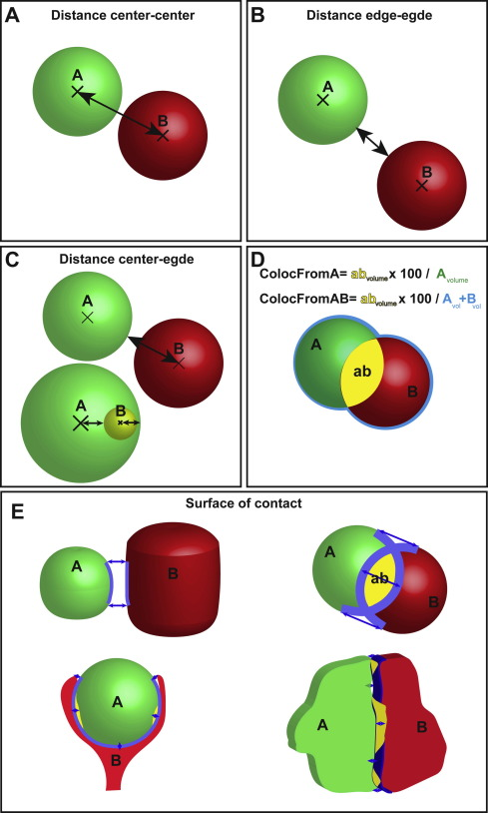
Object based analysis
Segmentation: Object / background
Connexity analysis: definition of objects
Calculation of colocalized volume, area, centroids..
☺
Less dependent on intensities. May be automated.
→
Objects need to be segmentable; not for diffuse labelling.

Slide 10
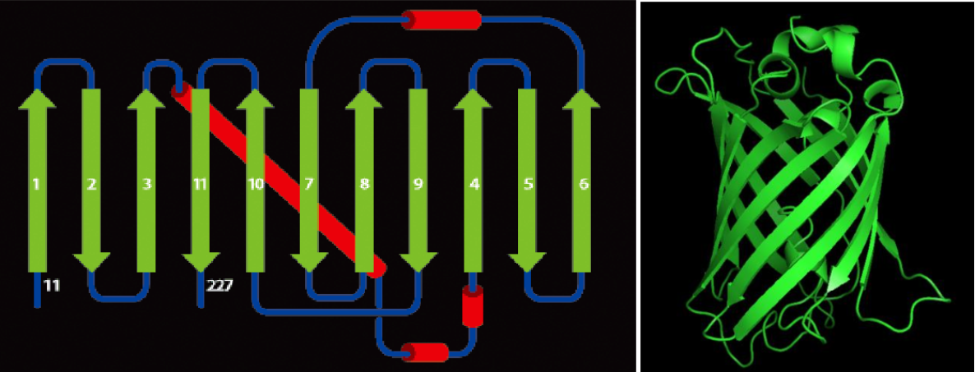
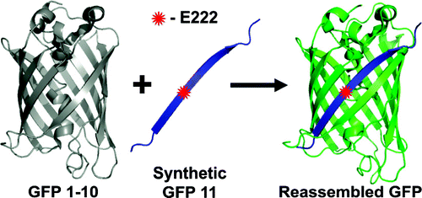
Improved FP based tagging: the splitFP
Superfolder GFP (GFP con una struttura energeticamente super stabile)
Barrel strands
Chromophore
Split GFP: GFP ingenierizzata in 2 frammenti separati. Il folding corretto esiste solo se I due frammenti sono sufficientemente vicini tra loro

Slide 11
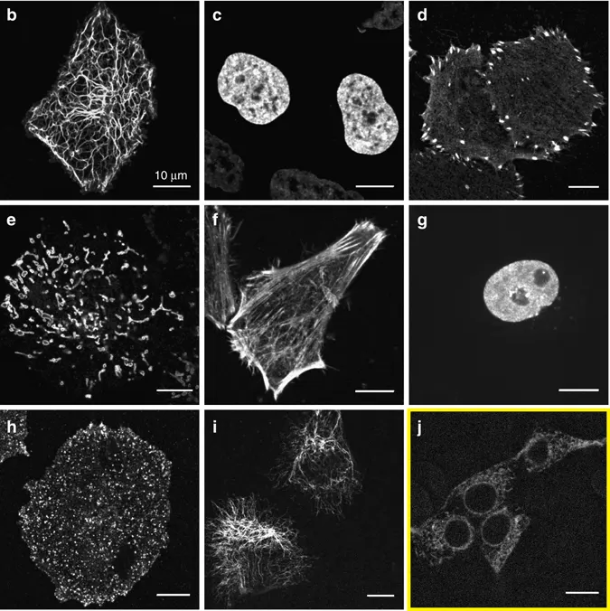
Protein localization by splitGFP
GFP1-10
plasmid
GFP11-target
plasmid

Slide 12
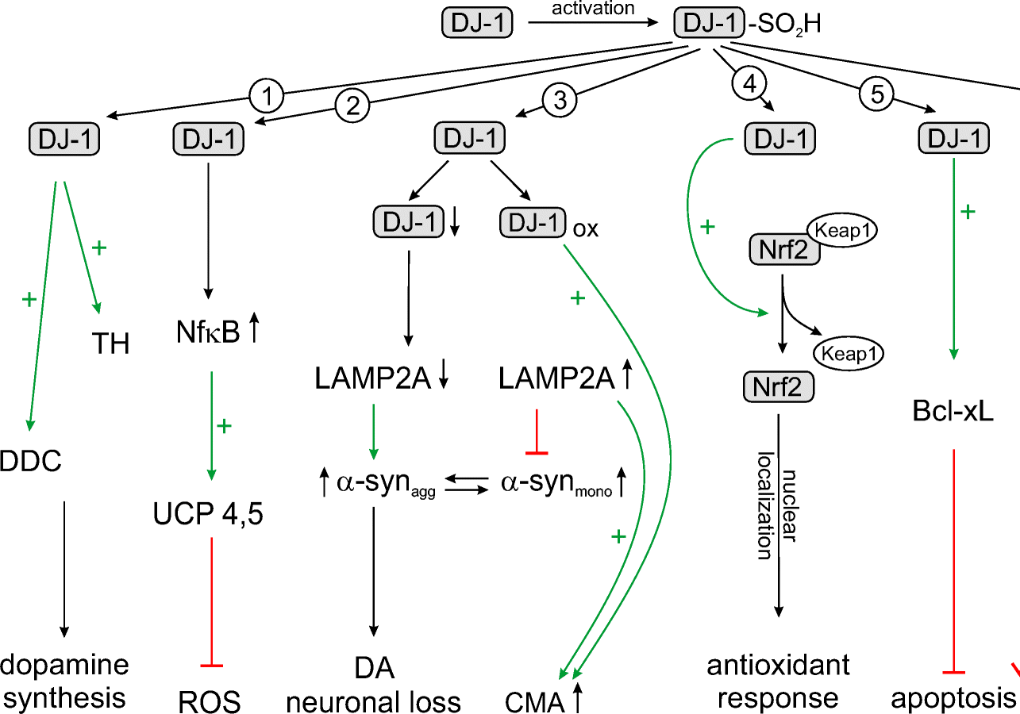
Protein localization by splitGFP #2 The case of DJ-1
DJ-1: Protein/nucleic acid deglycase – mutato in forme familiari di Parkinson
Upregulate dopamine synthesis via direct activation of tyrosine hydroxylase (TH) and 4-dihydroxy-L-phenylalanine decarboxylase (DDC).
Transcriptional coactivator of NF-kB and subsequent transcription of the gene encoding UCP4.
Prevents toxic a-syn aggregation via chaperone-mediated authophagy (CMA).
Stimulates endogenous antioxidant system by the activation of Nrf2.
DJ-1 upregulates and stabilizes Bcl-xL

Slide 13
Protein localization by splitGFP #2 The case of DJ-1
Other roles of DJ-1
It was proven to localize to mitochondria,
DJ-1 KO have impaired energy production, altered morphology and impaired Ca2+ buffering capacity
DJ-1 also localize to mitochondria to…?

Slide 14
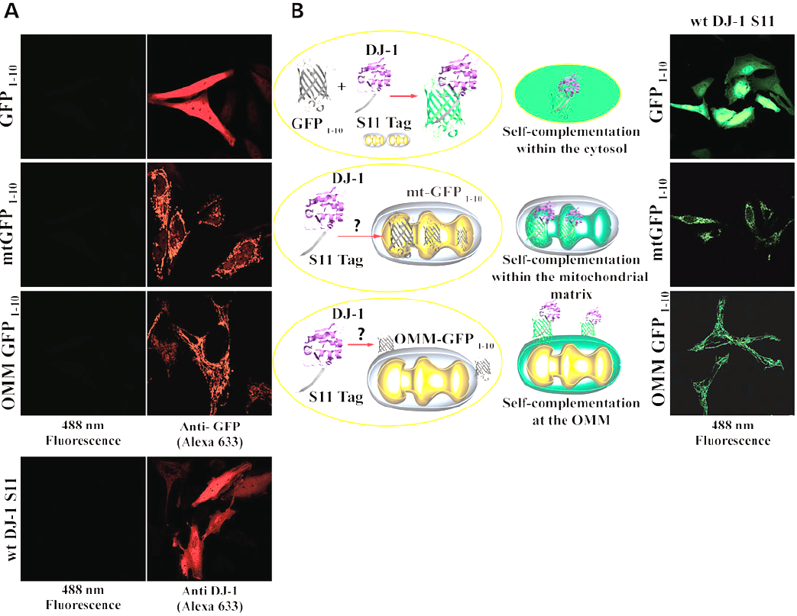
Split GFP probe for DJ-1
Targeting GFP1-10 allows compartment dependent localization of a target protein

Slide 15
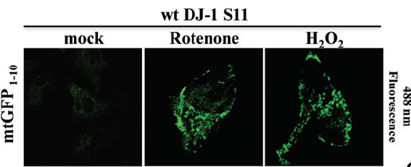
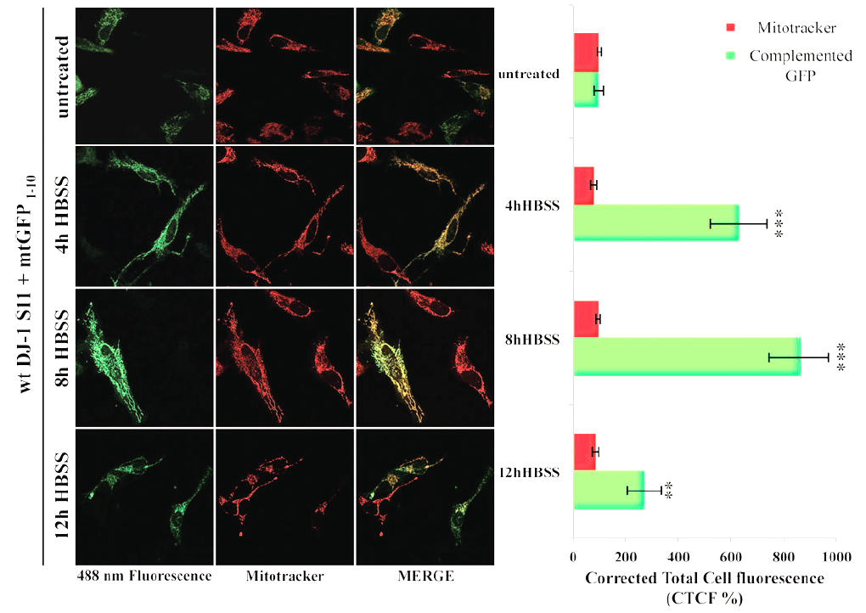
DJ-1 localization to matrix is ROS and starting dependent

Slide 16
Split GFP tagging
Pro:
Smaller tag then full GFP,
CAN better resolve spatial localization,
Cons
Tagging can affect protein function or can be masked by folding,
Requires a good design,
Superfolder properties are not very good for protein interation

Slide 17
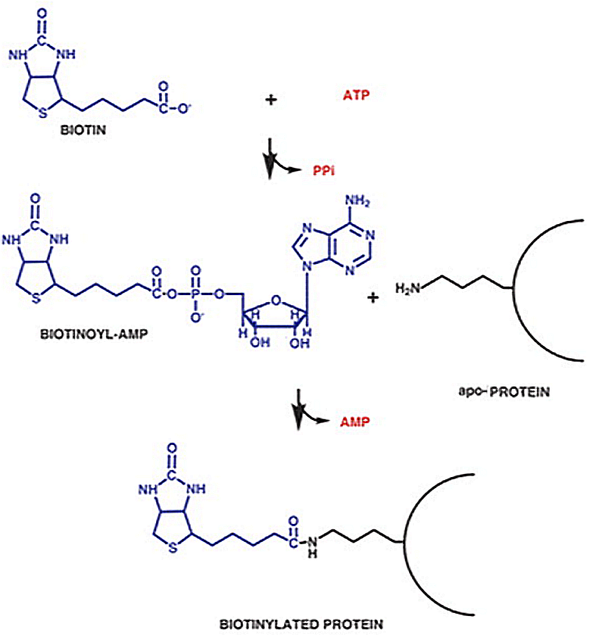
Taggin for proximity biotinilation
Reazione di BirA
Metodo enzimatico per la biotinilazione di proteine,
Precise enzimi possono rendere la biotina super reattiva
Basato sulla biotina ligase di E. Coli BirA
Il target richiede una sequenza peptidica precisa (AviTag)

Slide 18
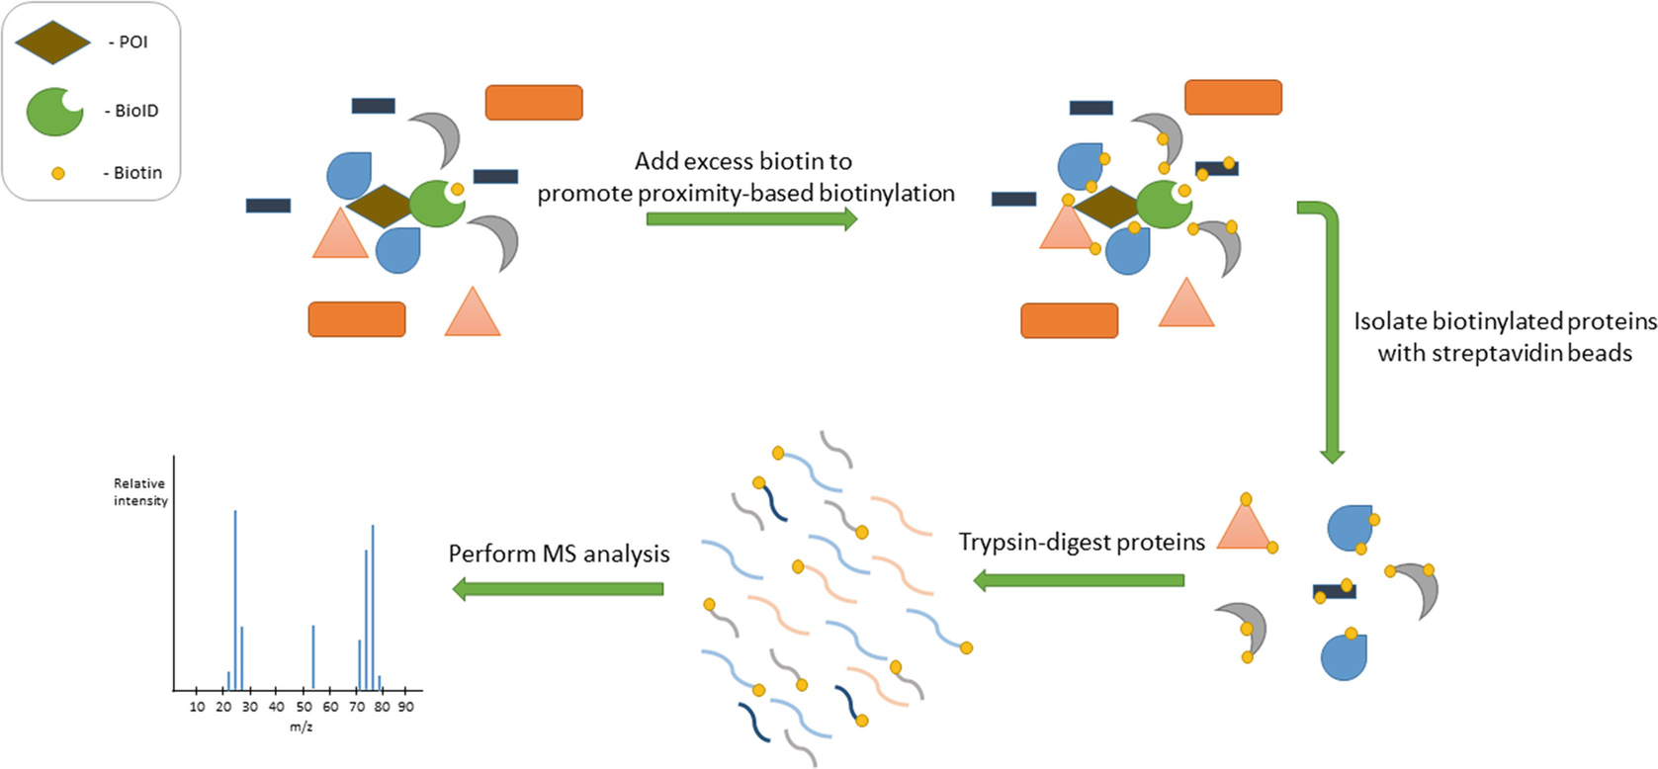
Tagging for proximity biotinilation: BioID
BioID: mutante di BirA incapace di trattenere Biotina-AMP
Biotina-AMP e’ immediatamente rilasciata dal sito catalitico e reagisce con tutte le ammine primarie disponibili (Arginina, Lysina, Glutammina, Asparagina)
Biotina-AMP emivita <20-10nm
Reazione relativamente lenta ≅ 15 ore

Slide 19
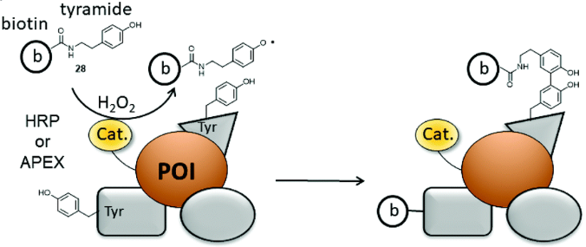
Taggin for proximity biotinilation: APEX
APEX: aspartate perossidasi
Attiva biotina tiramide (fenolo)
Richiede H2O2 come cofattore
Il radicale di biotina reagisce con sequenze ricche in elettroni (specialmente residui tirosinici)
Emivita comparabile a biotina AMP
Completa la reazione in pochi minuti
APEX
APEX

Slide 20
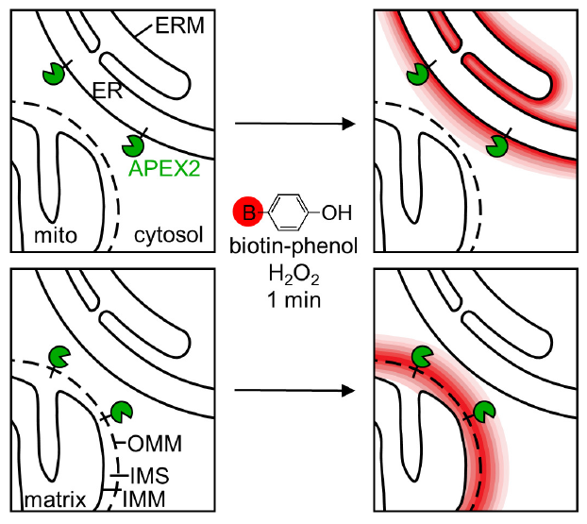
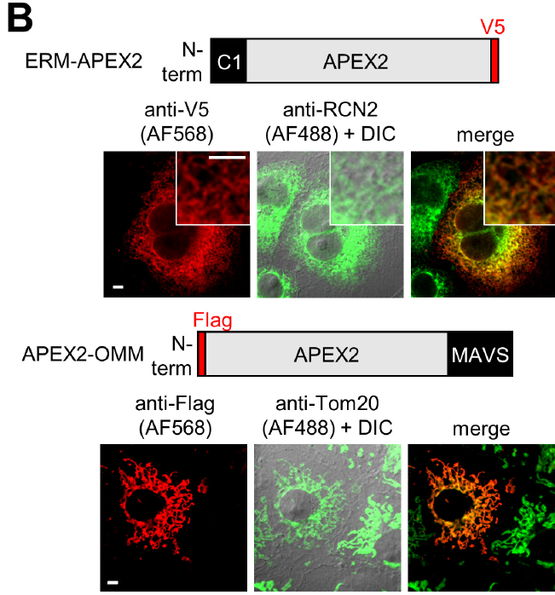
Tagging for proximity biotinilation: APEX

Slide 21
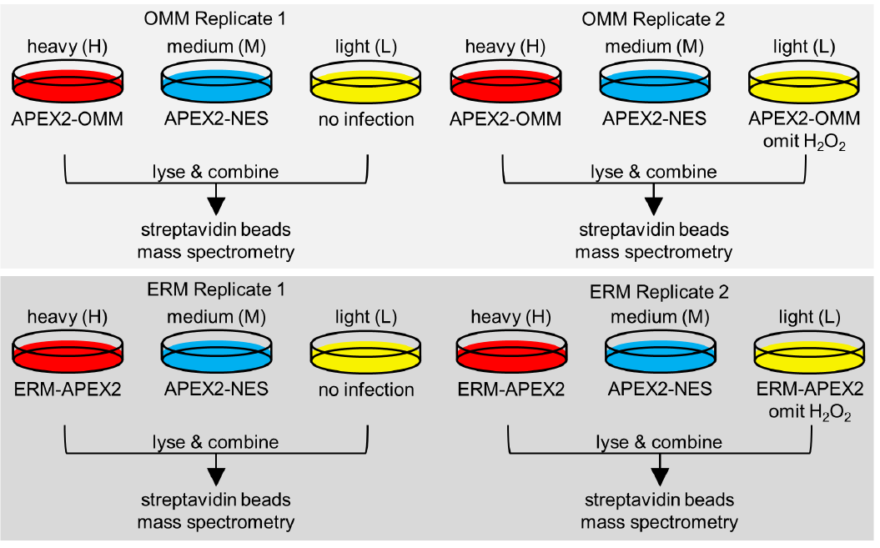
Tagging for proximity biotinilation: APEX

Slide 22
Tagging for proximity biotinilation: APEX

Slide 23
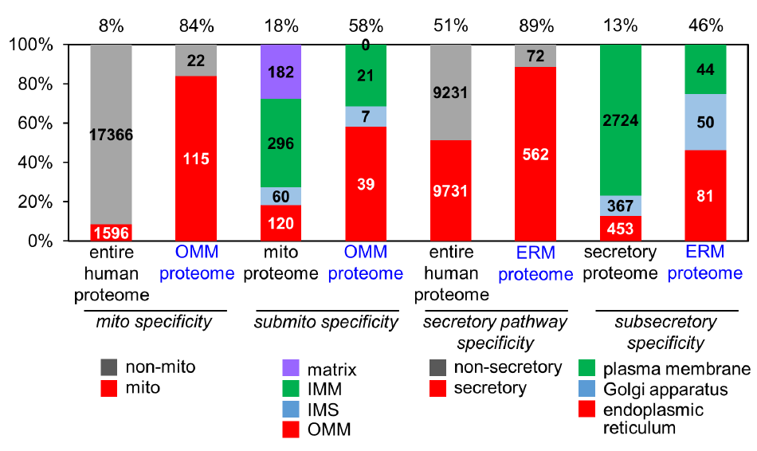
Tagging for proximity biotinilation: APEX

Slide 24
Questions?

