Slide 1
Techniche di localizzazione proteica – Parte 1
Biochimica applicata lezione 05

Slide 2
Overview delle tecniche di localizzazione
Frazionamento cellulare + SDS-PAGE
Separazione di compartimenti cellulari + detection
Immunostaining + microscopia
Detection diretta “in cellula”
Protein Tagging + microscopia
Detection semi-diretta (indiretta) “in cellula”

Slide 3
IMMUNOFLUORESCENZA
Si basa sull’interazione Antigene/Anticorpo
Usa un sistema di rivelazione basato su fluorofori
METODO DIRETTO
METODO INDIRETTO
DETERMINAZIONE DI ANTIGENI
DETERMINAZIONE DI ANTICORPI
Anticorpo:
Primario, lega l’antigene target
(puo’ avere un tag fluorescente)
Secondario, lega l’anticorpo primario
(e’ necessariamente taggato)

Slide 4
IMMUNOFLUORESCENZA
Preparazione del campione: dissezione, inclusione, taglio.
Fissazione: chimica (es. paraformaldeide); fisica (es. congelamento rapido)
Permeabilizzazione: solventi organici o detergenti (Triton X-100, Tween 20)
Blocco siti aspecifici: proteine inerti (albumina) o siero normale della stessa specie del secondario
Anticorpo primario: tempi, temperature e concentrazioni dell’Ab
Anticorpo secondario: visualizza il primario amplificandone il segnale
Lavaggi: eliminano l’aspecifico
Controlli: necessari
Positivo: campione che sicuramente esprime l’antigene
Negativo: campione che sicuramente non esprime l’antigene

Slide 5
Artefatti tipici delle IF
Perdita di segnale da fluorofori preesistenti
Agglomerazione di protein target
2% PFA +
0.05% glutaraldehyde
Mascheramento dell’epitopo
2% PFA +
0.1% triton 15min

Slide 6
Perche’ si originano gli artefatti?
Fixation:
arrests the sample in a live‐like state
ideally should fix everything (proteins, lipids, nucleic acids, …)
must not block access for labels (antibodies, lipid dyes, DNA dyes, …)
Common fixatives:
dehydrating:
methanol (precipitates proteins)
aldehydes (crosslinking):
formaldehyde
glutaraldehyde
Permeabilisation:
opens cell boundaries (plasma membrane, organelles) to antibodies and other labels
should not affect the shape of the cell or organelles
should leave localisation of proteins in membranes intact
Permeabilising agents:
saponin
non‐ionic detergents
methanol

Slide 7
Dehydrating fixatives: methanol, ethanol, acetone
for microscopy, usually methanol is used
replaces water from the proteins surface, thereby inducing precipitation
low temperature (usually ‐20C) and short incubation avoid denaturation of proteins (preserves antigens for staining)
➔ also solubilises membrane lipids (permeabilisation)
Possible side effects and considerations
Cell structures poorly preserved,
Protein precipitation might mask epitopes
Aldehyde‐based fixatives: formaldehyde, glutaraldehyde
Possible side effects and considerations
destruction or shielding of epitopes for antibody staining
most proteins are fixed within seconds, but some very dense or loose complexes can take hours
changed protein conformation (loss of fluorescence of fluorescent proteins)
left‐over aldehyde groups react with any amine group ➔ high background staining
fluorescent side products (aldehyde reactions)
lipids are not crosslinked
The fixative action of formaldehyde is due to its reactions with proteins
Substances such as carbohydrates, lipids and nucleic acids are trapped in a matrix of insolubilized and cross‐linked protein
molecules but are not chemically changed by formaldehyde

Slide 8
Permeabilizzazione
Saponins (saponin, digitonin):
dissolves cholesterol from cholesterol‐rich membranes (mainly plasma membrane)
leaves nucleus and Golgi largely intact
saponin
Saponaria officinalis (soapwort)
digitonin
non‐ionic detergents (Triton‐X100, NP40):
dissolve all lipids
Digitalis purpurea (foxglove)
triton X‐100
methanol:
dissolves all lipids
tween‐20
➔ precipitates proteins at the same time

Slide 9
Diverse strutture diversi comportamenti

Slide 10
Come evitare gli artefatti
use fresh chemicals:
prepare PFA freshly, adjust the pH carefully
ready‐to‐use fixatives (‘Fix&Perm’) contain preservatives (avoiding polymerisation) that can induce artefatcs; work for some samples but not other
Controls:
comparison live (fluorescent protein) / fixed (antibody staining)
➔ caution: fluorescent proteins tend to dimerise / oligomerise and can interfere with protein functions / interactions
comparison various fixation / permeabilisation chemicals, protocols and conditions
comparison various cell types
positive control: known physiological effect (change in expression and / or localisation of protein of interest)
Observation:
optimise cell viability before fixation
observe samples throughout fixation / permeabilisation process

Slide 11
Controllo positivo: effetto giologico
anti‐GFP Alx‐633
GFP
neg control (unstimulated)
stimulation (PKD translocation)

Slide 12
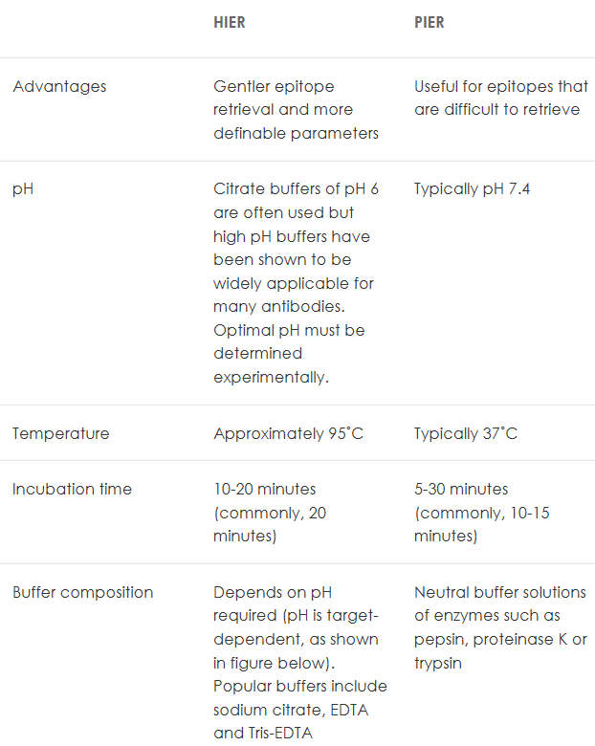
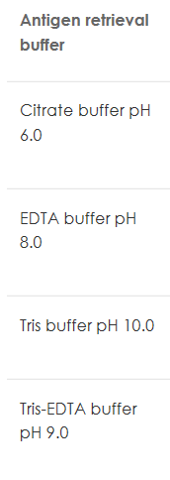
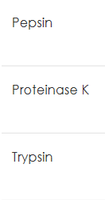
Antigen retrieval
HIER: heat induced
PIER: Protease induced

Slide 13
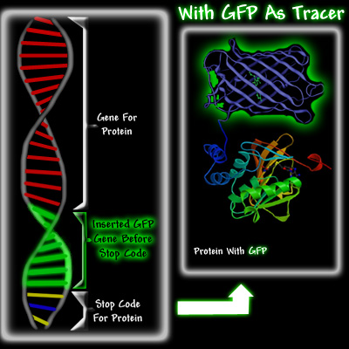
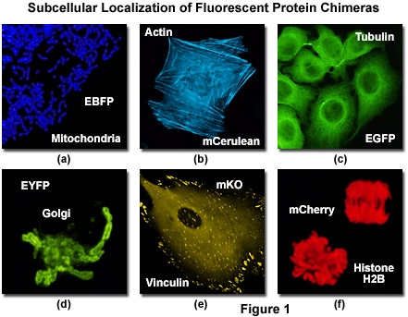
Determinazione localizzazione intracellulare tramite tagging con FPs
Fusione in frame con la protein di interesse
Fusione in frame con una sequenza di localizzazione

Slide 14
Vantaggi di FP tagging
Limitata quantita’ di campione
No artefatti da fissaggio/permeabilizzazione/affinita’ anticorpo
LIVE! – analisi dinamica del comportamento di una proteina nel contesto nativo

Slide 15
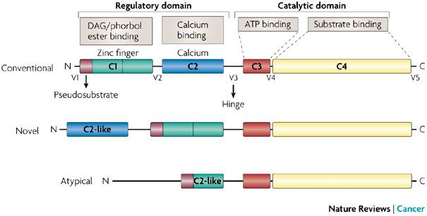
L’esempio delle PKC
Ca²⁺ DAG
Classical (α, βΙΙ) + +
New (δ, ε) - +
Atypical (λ, ζ) - -

Slide 16
PKC
GFP
PKC alpha
PKC epsilon
PKC zeta
PKC beta
PKC delta

Slide 17
FRAP: fluorescence recovery after photobleaching
Tecnica in fluorescenza che permette di misurare coefficienti di diffusione di un fluoroforo

Slide 18
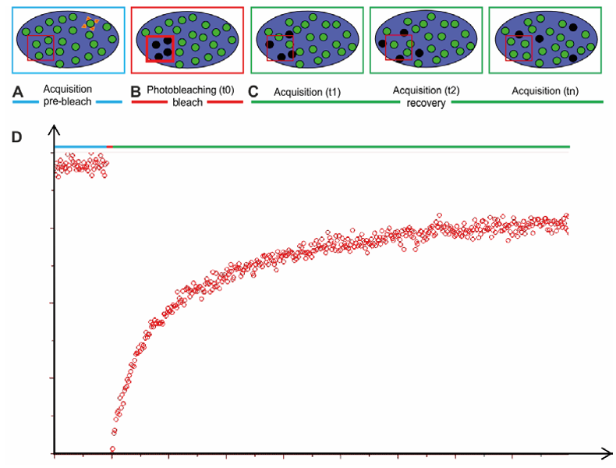
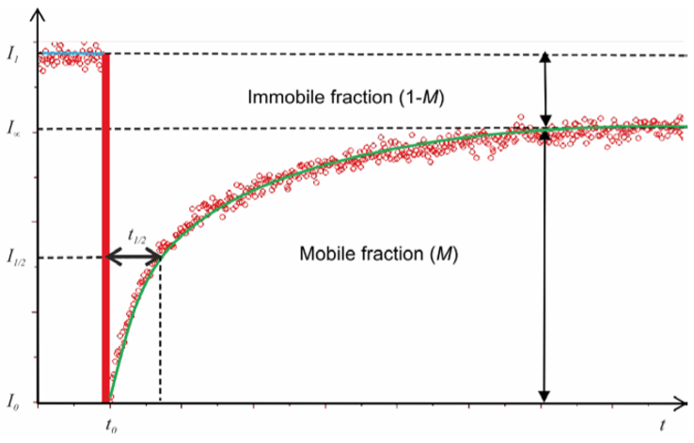
FRAP: fluorescence recovery after photobleaching
- T=1/2: tempo richiesto a recuperare il 50% della - fluorescenza persa – indice di diffusibilita’
- Mobile/immobile fraction: indice della presenza di strutture molecolari complesse

Slide 19
FRAP: circolazione tra compartimenti
Cycloeximide
Galactosyltransferase-GFP: Proteina del Golgi che viene sintetizzata nell’ER
Cycloheximide: inibitore della sintesi proteica

Slide 20
FLIP: Fluorescence loss in phtotobleaching

Slide 21
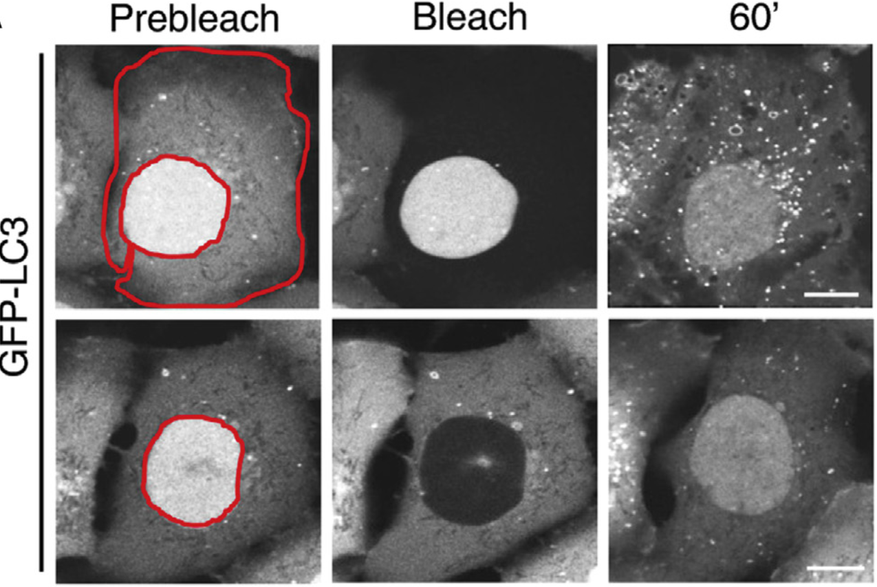
iFRAP: FRAP inverso

Slide 22
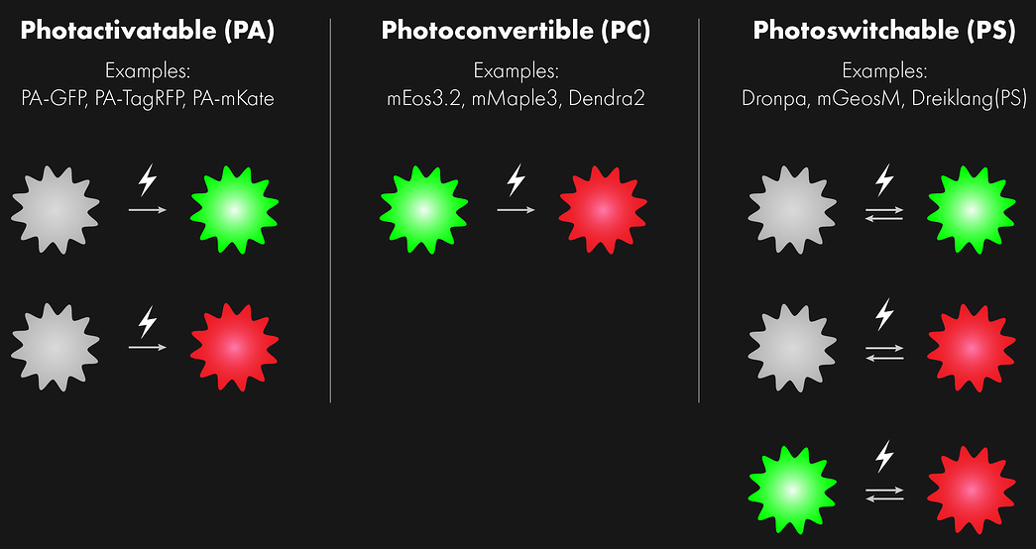
Evoluzione del FRAP: Optical highlighter
Vantaggi rispetto FRAP:
Richiedono meno luce,
Permettono di vedere il target dopo la stimolazione,
PALM (superrisoluzione)

Slide 23
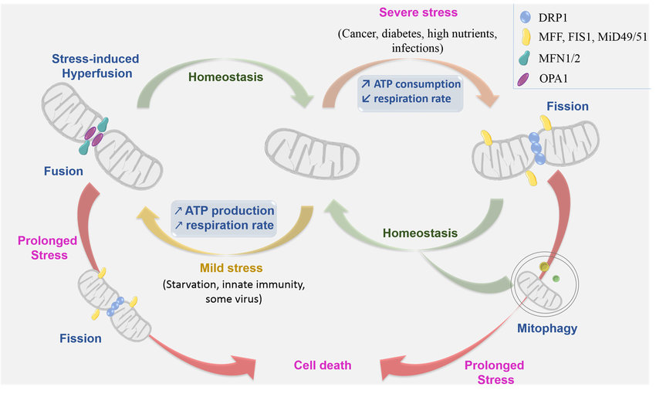
Analisi Fusione/Fissione mitochondriale tramite fotoattivazione
mt-DsRed
mt-PA-GFP
Photoactivation site

Slide 24
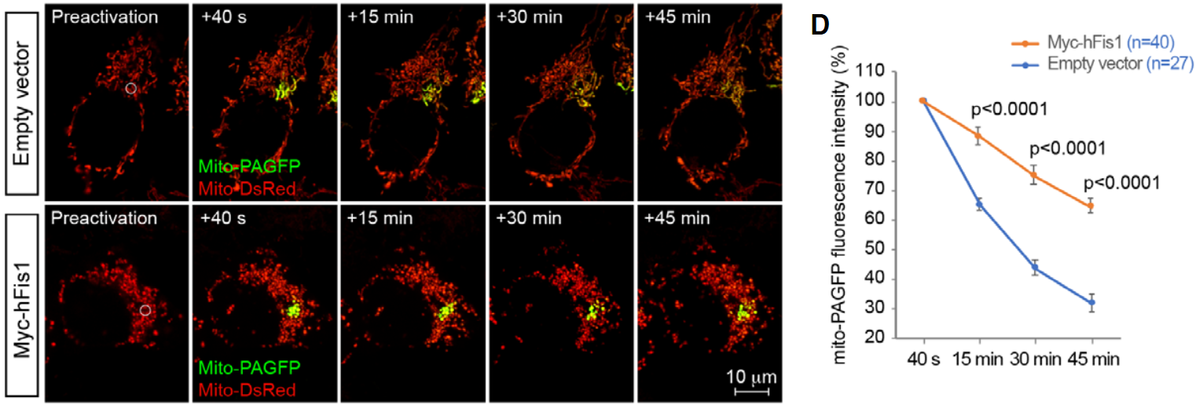
Analisi Fusione/Fissione mitochondriale tramite fotoattivazione

Slide 25
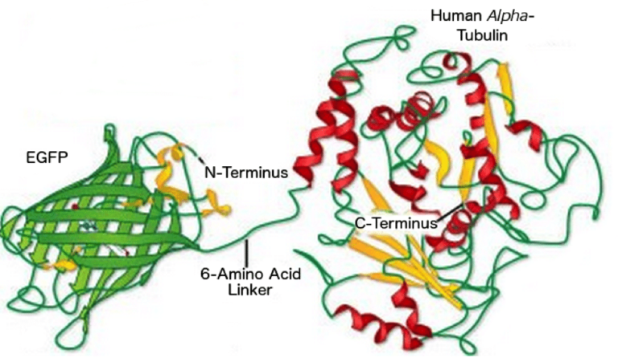
Svantaggi (spesso dimenticati) di FP tagging
Per quanto piccolo GFP rimane una proteina (30KD);
Interferire con la localizzazione del target,
Interferisce con il folding,
N- or C-terminus? (target e GFP)
La trasfezione puo’ mislocalizzare il costrutto,
Tendenza ad aggregare (o rimanere visible nei lisosomi),
Talvolta il costrutto e’ citotossico..

Slide 26
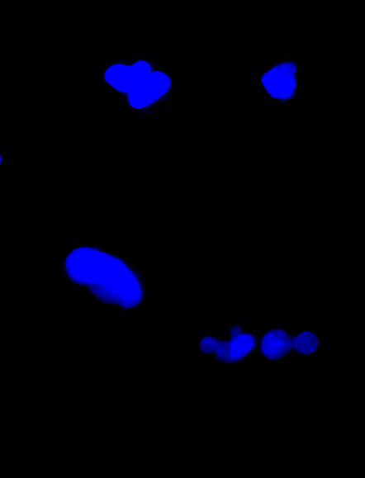
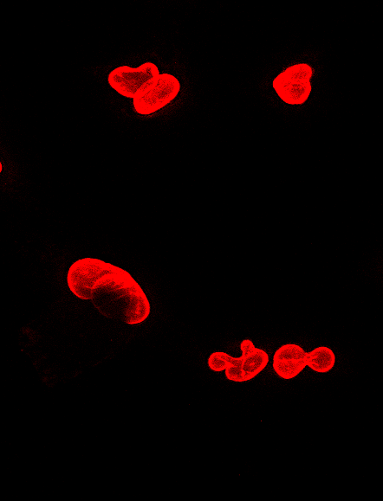
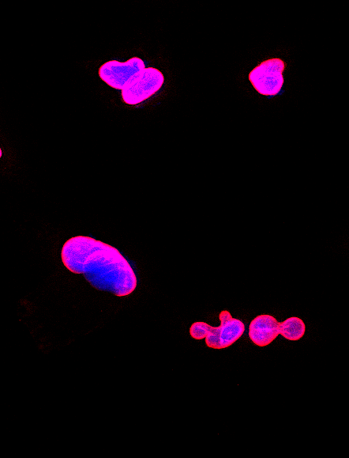
Misura della localizzazione: Co-localizzazione
Come si quantifica la localizzazione?
DAPI
Lamin A/C
Merge

Slide 27
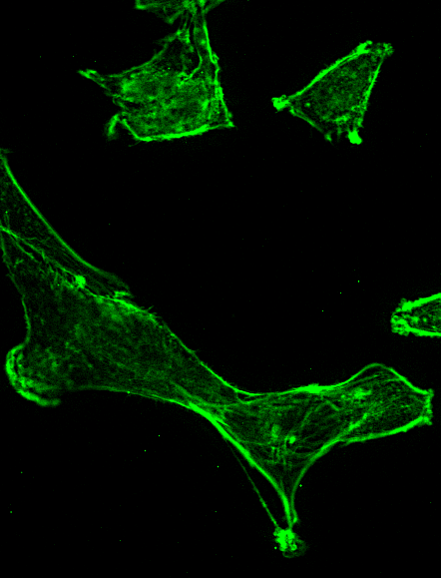
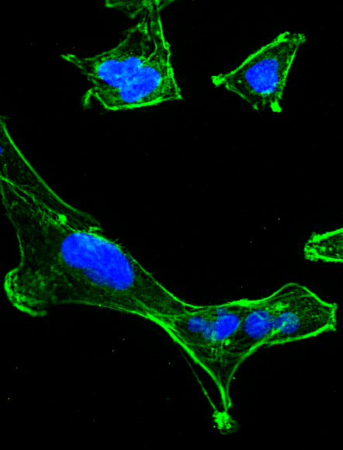
Come si quantifica la localizzazione?
DAPI
Actin
Merge

Slide 28
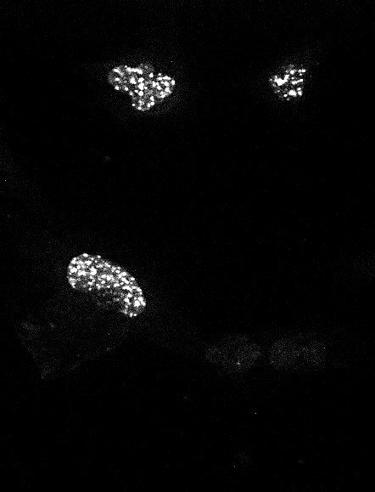
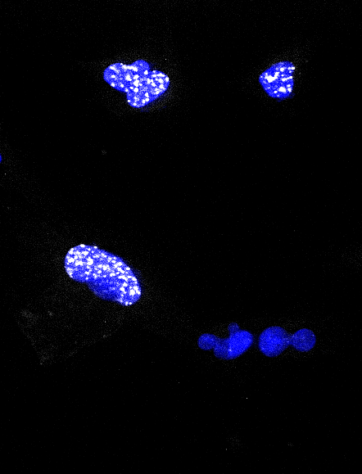
Come si quantifica la localizzazione?
DAPI
pHH3
Merge

Slide 29
Colocalization in fluorescence microscopy at subcellular level
Definition: The presence of two or more fluorochromes on the same physical structure in a cell.
www.olympusconfocal.com/applications/colocalization.html
Limitation in best case scenario: optical resolution of microscope (Light microscope: 200 x 200 x 400 nm)
Colocalization never measures interaction, it just states that two dyes are close in a defined volume.

Slide 30
Guidelines for preparation and acquisition of samples for colocalization analysis
Choice of fluorochromes: not too close, not too far (bleedthrough, chromatic aberration)
FITC/Cy3
Controls: for positive and negative colocalization, autofluorescence, single labelled controls
Confocal; Widefield/ Deconvolution
Appropriate objective (high numerical aperture (leads to small detection volume), highly corrected)
Avoid bleedtrough/ crosstalk
Minimize noise (Confocal: averaging/low speed; Widefield: camera, optimize exposure time)
Dynamic range: use whole range, no saturation
Proper sampling frequency (Nyquist sampling: about 3 pixels over resolution distance)

Slide 31
Analysis Tools
Visualization
Quantification
RGB overlay
Intensity based
Object based
Correlation of the strength of linear relation between two channels.
Structure identification and determination of overlap
of objects.

Slide 32
Colocalization visualization green + red = yellow ?
Bolte et al., Journal of Microscopy 2006,Vol. 224, 213
Don`t trust your eyes in colocalization. Never overlay 3D projections.

Slide 33
Analysis Tools
Visualization
Quantification
Intensity based
Correlation of the strength of linear relation between two channels.
RGB overlay
Object based
Structure identification and determination of overlap
of objects.

Slide 34
Intensity correlation based analysis
The scatterplot/ 2D histogramm:
The coefficients:
Pearson coefficient Manders coefficients Costes approach

Slide 35
The scatterplot
Overlay green/red
☺
Good first visual estimate of colocalization. Information about image quality.
Only qualitative correlation.
Bolte et al., Journal of Microscopy 2006,Vol. 224, 213

Slide 36
Which scatterplot belongs to which image series?
1
2
3
4
Result: A3, B1, C4, D2
Bolte et al., Journal of Microscopy 2006,Vol. 224, 213

Slide 37
The Pearson Coefficient (PC): The Formula
Rr= 1: perfect colocalization Rr= 0: random localization Rr= -1: perfect exclusion

Slide 38
Understanding the Pearson Coefficient
PC:-0.108
PC:0.169
PC:0.446 PC:0.446 PC:0.446 PC:0.228
☺ The PC is not dependent on a constant background and on image brightness.
The PC is not easy to interpret and affected by addition of non- colocalizing signals. No perspective of both channels.

Slide 39
Manders coefficients
M1, M2 coefficient:
Proportion of overlap of each channel with the other.
(Manders et al. , 1993)
M = 1: perfect colocalization M = 0: no colocalization

Slide 40
Understanding the Manders coefficients
PC:-0.108 M1:0.000 M2:0.000
PC:0.169 M1:0.250 M2:0.250
PC:0.446 M1:0.500 M2:0.500
PC:0.446 M1:1.000 M2:0.163
PC:0.228 M1:0.500 M2:0.286
PC:0.446
M1:0.500 M2:0.500
☺
The Manders coefficients are easier to interpret than the PC. They are not sensitive to the intensity of overlapping pixels.
→
They are sensitive to background. A threshold has to be set!

Slide 41
The influence of noise on the Pearson and Manders Coefficients
PC:0.446
PC:0.422
PC:0.398
M1:0.500 M2:0.500
M1:0.490 M2:0.260
M1:0.490 M2:0.180
All these coefficients are influenced by noise.
Minimize noise at acquisition and eventually deconvolve your dataset prior to analysis.
Deconvolution improves colocalization analysis of multiple fluorochromes in 3D confocal data sets more than filtering techniques. L. Landmann. Journal of Microscopy 208:2, 134 (2002).

Slide 42
Analysis Tools
Visualization
Quantification
Object based
Structure identification and determination of overlap
of objects.
Imaris, ImageJ
RGB overlay
Intensity correlation based
Correlation of the strength of linear relation between two channels.

Slide 43
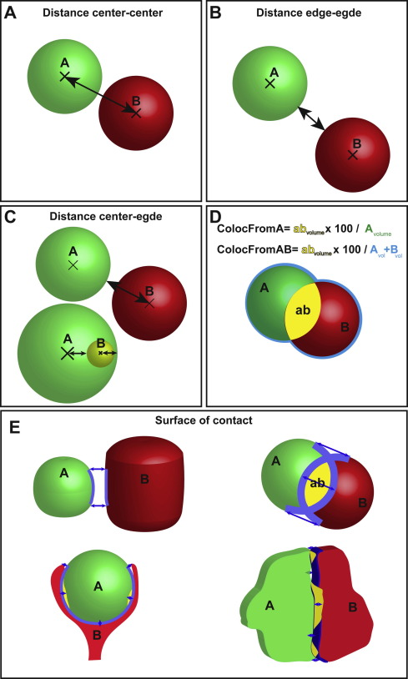
Object based analysis
Segmentation: Object / background
Connexity analysis: definition of objects
Calculation of colocalized volume, area, centroids..
☺
Less dependent on intensities. May be automated.
→
Objects need to be segmentable; not for diffuse labelling.

